Slide 1
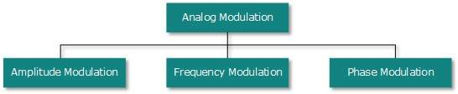
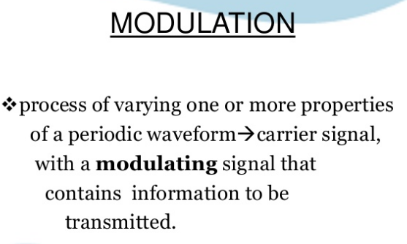
Analog-to-Analog Conversion
Analog signals are modified to represent analog data. This conversion is also known as Analog Modulation. Analog modulation is required when bandpass is used. Analog to analog conversion can be done in three ways:

Slide 2
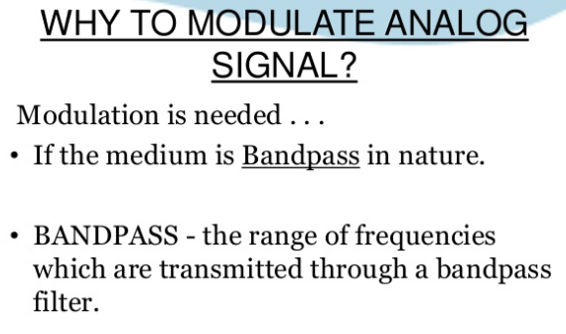
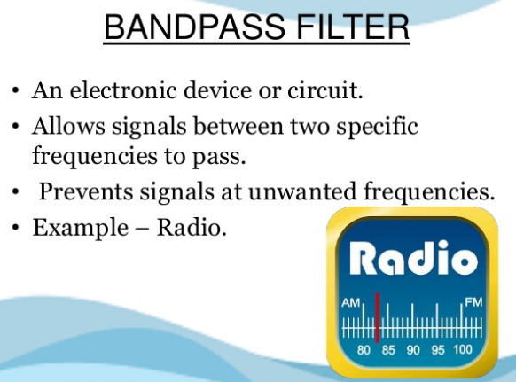

Slide 3
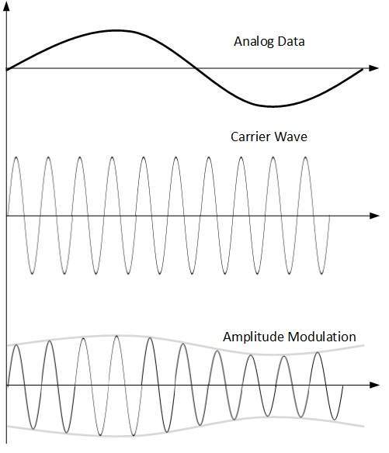
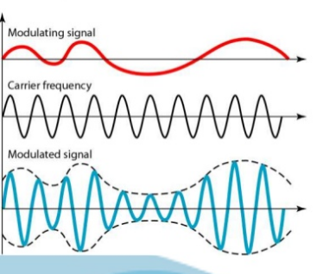
Amplitude Modulation
In this modulation, the amplitude of the carrier signal is modified to reflect the analog data.
Amplitude modulation is implemented by means of a multiplier. The amplitude of modulating signal (analog data) is multiplied by the amplitude of carrier frequency, which then reflects analog data.
The frequency and phase of carrier signal remain unchanged.

Slide 4
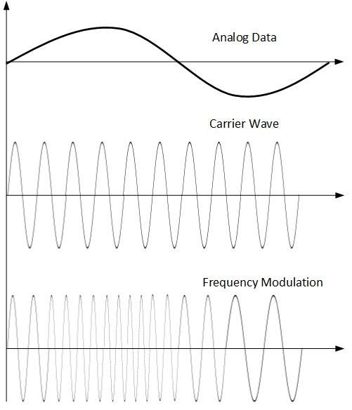
Frequency Modulation
In this modulation technique, the frequency of the carrier signal is modified to reflect the change in the voltage levels of the modulating signal (analog data).
The amplitude and phase of the carrier signal are not altered.

Slide 5
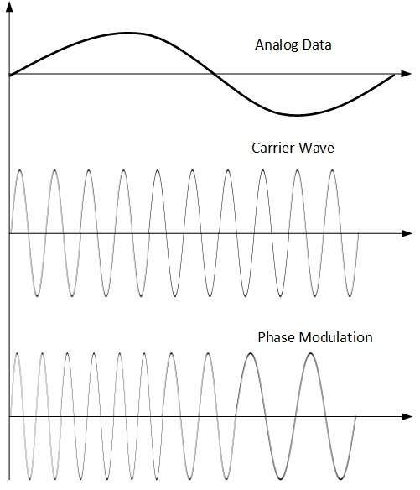
Phase Modulation
In the modulation technique, the phase of carrier signal is modulated in order to reflect the change in voltage (amplitude) of analog data signal.
Phase modulation is practically similar to Frequency Modulation, but in Phase modulation frequency of the carrier signal is not increased. Frequency of carrier is signal is changed (made dense and sparse) to reflect voltage change in the amplitude of modulating signal.

